Slide 1


Artificial Intelligence Foundation

Slide 2


The Foundations of Intelligence

Slide 3
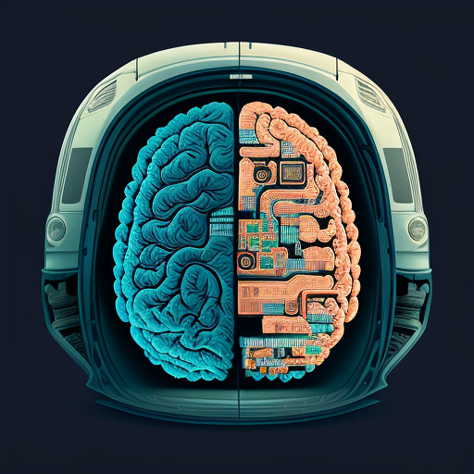
Cognitive Milestones Overview
The evolution of human intelligence is marked by critical milestones such as the development of complex tools, the advent of language facilitating advanced communication, and the emergence of symbolic thought, all of which reflect significant cognitive advancements that distinguish humans from other species.
Evolution of Human Intelligence

Slide 4

What Is Artificial Intelligence?
Definition and Purpose
Artificial Intelligence encompasses the development of algorithms and systems that enable machines to perform tasks requiring human-like cognitive functions, aiming to enhance automation, efficiency, and decision-making across various applications.

Slide 5
History of Artificial Intelligence
ELIZA, an early natural language processing program, simulates conversation with users.
Expert systems gain traction, finding applications in medicine and finance.
AI technologies become integral in daily life, influencing various sectors and applications.
1956
1970s
2012
1
2
3
4
5
6
The Dartmouth Conference marks the formal birth of AI as an academic discipline.
1966
The field experiences the "AI Winter" due to unmet expectations and funding cuts.
1980s
Breakthroughs in deep learning lead to significant advancements in image and speech recognition.
2023

Slide 6
Areas Of Artificial Intelligence
01
02
03
Diverse Subfields of AI
Interdisciplinary Nature
Real-World Applications
Artificial Intelligence encompasses various subfields, including machine learning, natural language processing, computer vision, and robotics, each contributing unique methodologies and applications to enhance intelligent systems.
AI integrates principles from computer science, mathematics, psychology, and neuroscience, fostering collaboration across disciplines to advance the development of intelligent technologies.
AI technologies are increasingly applied in diverse sectors such as healthcare, finance, transportation, and entertainment, driving innovation and improving efficiency in processes and decision-making.

Slide 7





AI Vs Data Science Vs Machine Learning
Strength in Integration
The synergy between AI, Data Science, and Machine Learning enhances capabilities, allowing for more sophisticated data analysis and intelligent decision-making processes.
Weakness in Complexity
The intricate nature of these fields can lead to challenges in understanding and implementing effective solutions, often requiring specialized knowledge and skills.
01
02
Opportunities for Innovation
Threat of Misuse
03
04
The potential for ethical concerns and misuse of AI and data-driven technologies poses significant risks, necessitating robust governance and regulatory frameworks to ensure responsible use.
Rapid advancements in technology present opportunities for developing new applications and improving existing systems across various industries, driving growth and efficiency.

Slide 8

Applications of Deep Learning Networks
Enhanced Image Recognition
Deep learning networks, particularly CNNs, have revolutionized image recognition tasks, enabling applications in security, healthcare, and social media by providing high accuracy in identifying and classifying visual data.
Advanced Language Understanding
In NLP, deep learning models like transformers have significantly improved the ability to understand context and semantics, leading to more effective machine translation and sentiment analysis across various languages.
Predictive Healthcare Analytics
Deep learning is increasingly utilized in healthcare for predictive analytics, allowing for early disease detection and personalized treatment plans by analyzing vast amounts of patient data and medical records.

Slide 9
Thank You

